Slide 1
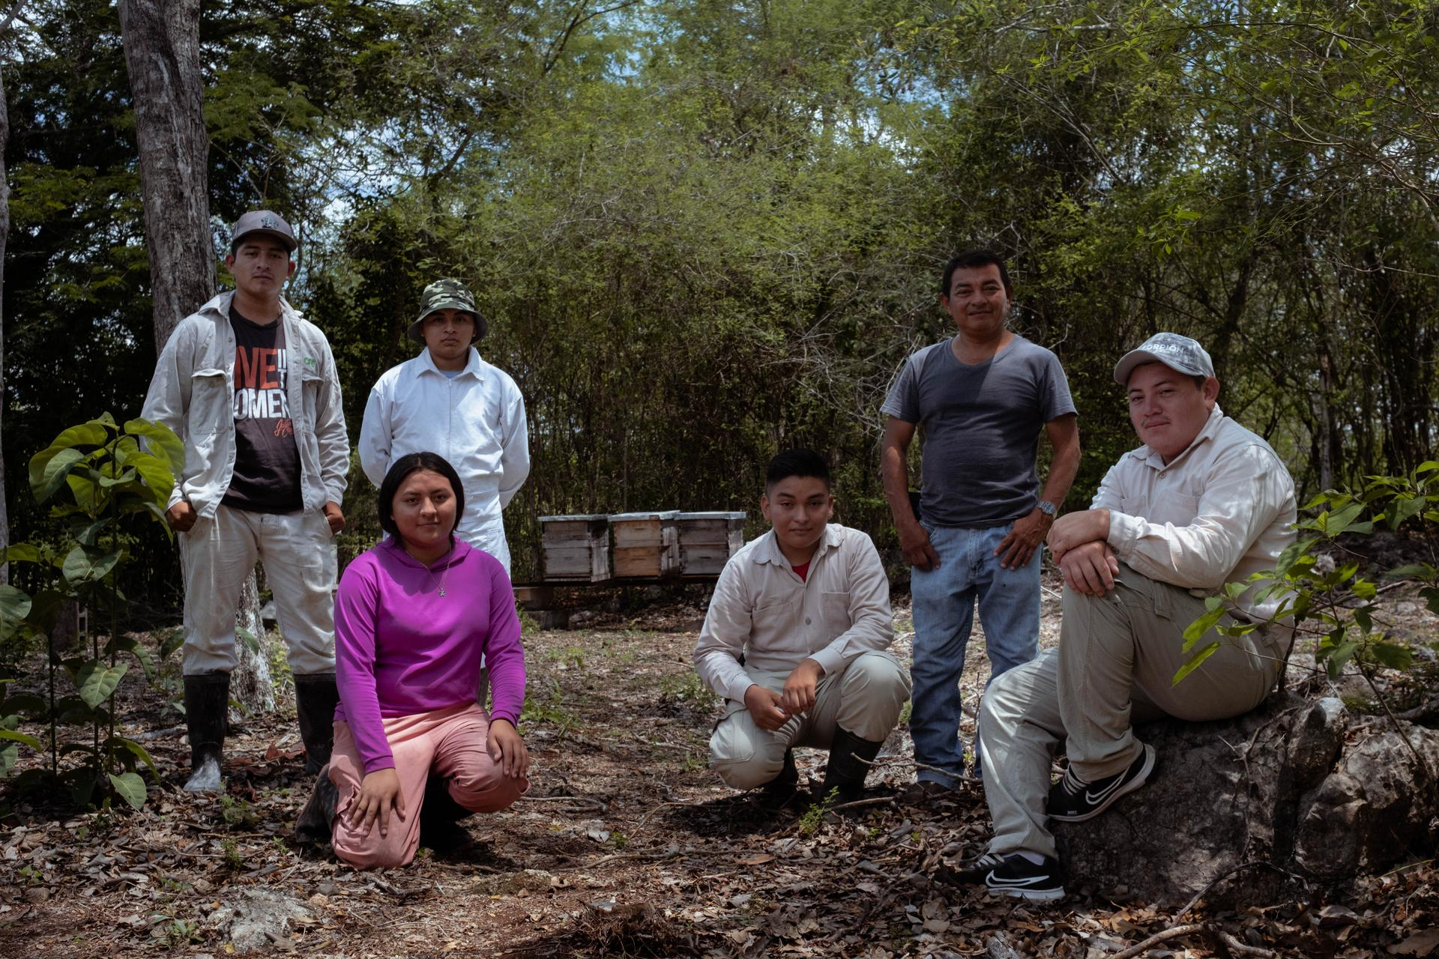
EDUCE
www.shared-interest.com
Notes:
Image shows A group portrait of Jorge Humberto Chan and his mentees
Established in 1997, Sociedad Cooperativa de Responsabilidad Limitada (EDUCE) is a co-operative dedicated to the production and export of Fairtrade honey. Today, EDUCE represents the voices and interests of 800 beekeepers in 40 co-operatives, across three states of the Yucatan Peninsula of Mexico. This area is known for its production of high-quality honey, particularly from the Melipona bee, which is native to the region. These bees are stingless and are known for their unique honey, which is prized for its medicinal properties and distinct flavour.
For Mayan communities, bees and honey have always been sacred. The honey produced in the region is harvested using traditional methods, which involve using small wooden boxes called “cajas” to house the bees and collect the honey. The cajas are placed in areas with abundant flowering plants, and the bees are left to forage and produce honey at their own pace. Once the honey is ready it is extracted using simple tools and techniques with minimal disruption to the bees and their habitat.
EDUCE first became a Shared Interest customer in 2002 when they received a loan to prefinance honey orders; they held this first facility until 2005. In 2015, we re-established contact with EDUCE and in 2016 they became a customer for the second time, receiving loans to prefinance their honey harvest.
EDUCE currently utilise the finance from Shared Interest to build stocks of honey and to prefinance honey contracts. Since working with Shared Interest the number of producer groups has increased from 63 to 113. EDUCE General Manger Miguel Ángel Munguía Gil explained the size of these groups ranges from 10 members to 140 members. He said: “Financing (from Shared Interest) has been key to increasing volume and growing.”
Speaking about the benefits of the Shared Interest loan, Commercial Manager Leonor López Garduza said: “The money allows the beekeepers to continue with their work maintain their families and be productive members of society. Without that money, the producers would be at the mercy of other traders who are less ethical.”

Slide 2
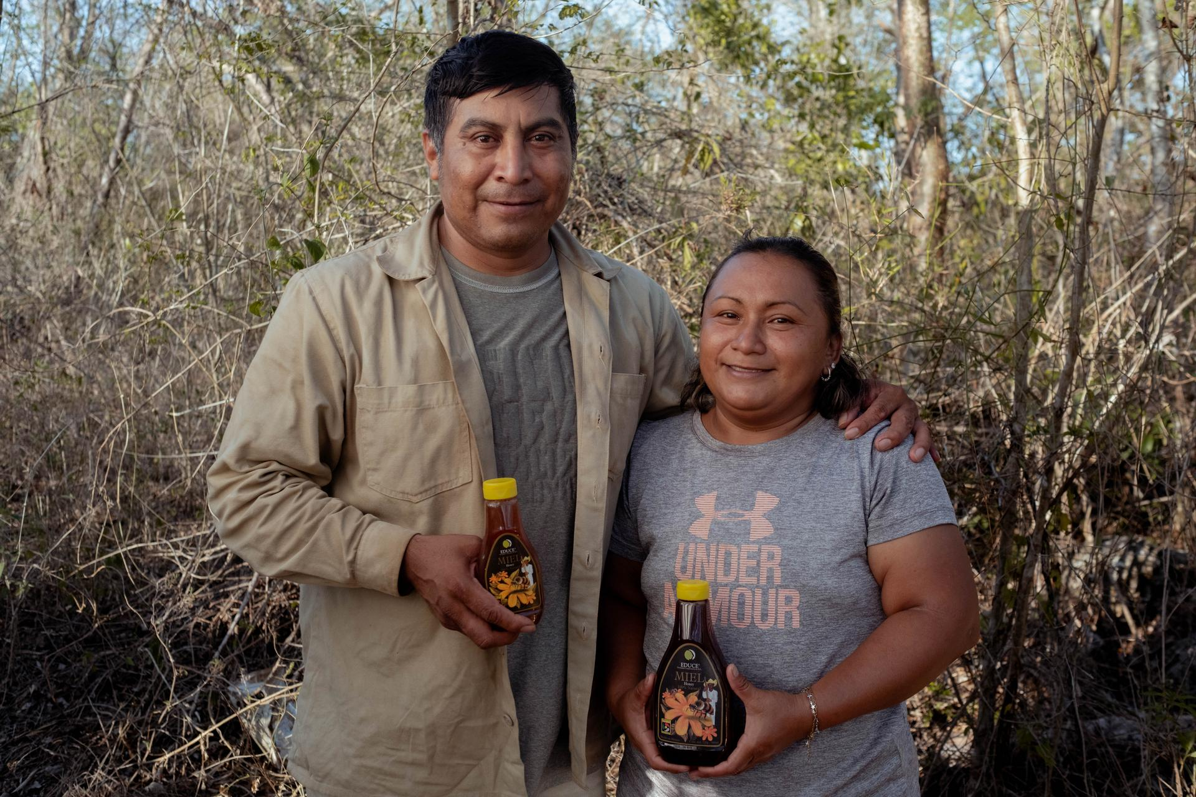
EDUCE
www.shared-interest.com
Notes:
Image shows María and Diego Colli hold the honey they produce with Educe.
María Colli has been an organic beekeeper for four years. She lives in Izamal in the region of Yucatán, Mexico.
María said: “The motivation why I was interested in joining with EDUCE was the price. It's a good price for us. And the other thing is that they give us workshops, they run workshops for us on gender and on the environment… This is very small town village and with a fair bit of machoism, and so these workshops they've opened our eyes perhaps. It's a pleasure for myself and the other women to have them. We used to be embarrassed to voice opinions or to speak up or we were shy but not anymore.
“EDUCE have shown us how to diversify our products, make other uses of our products and more than anything, it's given an opportunity as women specifically, before you didn't see any, there was no such thing as a woman beekeeper. But now there's myself and my group, we've been the first and there's another group forming as well.”

